Slide 1
CheckIt
Jonathan Asencio [Project Leader] - Back End - 014245983
Alex Philayvanh - Back End - 017508814
Bryan Bare - Back End - 011741260
Kunal Patel - Front End - 013329054

Slide 2
Password Check (Scope Creep)
In order to have our users create secure passwords that have been already been compromised in data breaches, we decided to incorporate the PwnedPasswords API.
To do this, we created two classes, Validation Handler and PasswordCheck.
Validation Handler receives a password to check to see if it has been compromised.
Validation handler then creates a hash from the password and sets it up to pass to the next class.
It sends a hashed prefix to PassWord check, which then calls the PwnedPassword API and sends back the results to ValidationHandler.
From there, ValidationHandler checks the results from PasswordCheck to see if the password has been compromised.
To further demonstrate this, our Sequence Diagram is as follows:

Slide 3
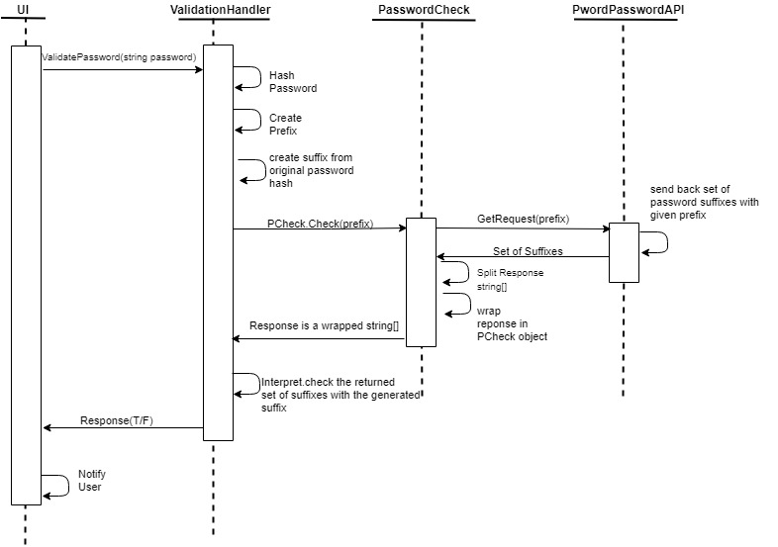
PasswordCheck Sequence Diagram

Slide 4
Authorization
Our idea to design Authorization came from the problem on how to develop certain permissible actions without creating a role based system. This lead us to design our Authorization based on how we store our users in the database. We decided to go with a hierarchical design. Users are stored in our database based on height. For example, a SysAdmin would be stored in our database with a height of 1, an Admin with a height of 2, and a User with a height of 3. You can think of this as a tree. With this design, we can add actions to a user without having to change the ‘type’ of user account. Authorization then can act as a series of checks. A diagram of our hierarchical design is as follows:

Slide 5
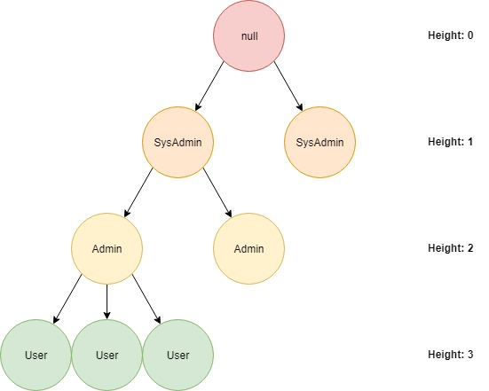
Hierarchy Design

Slide 6
Authorization
The hierarchy design allows us to perform User to User and System to Service requirements.
The Authorization feature is broken into 3 classes of which one is a Token which implements JSON Web Token (JWT)
AuthorizationManager is used to separate functions so that not one class controls all, preventing a ‘God Class’.
Authorization Manager calls certain functions inside the Authorization class that checks for certain permissible actions.
A token class is used in junction that uses a JWT to store user information.
This is done to not only store user information but to also secure the information. A example of this process is as follows:

Slide 7
Token
Object
Email
Actions
Client
Height
Jwt
Json Web Token (JWT)
Payload + Header → String
String → Payload + Header

Slide 8
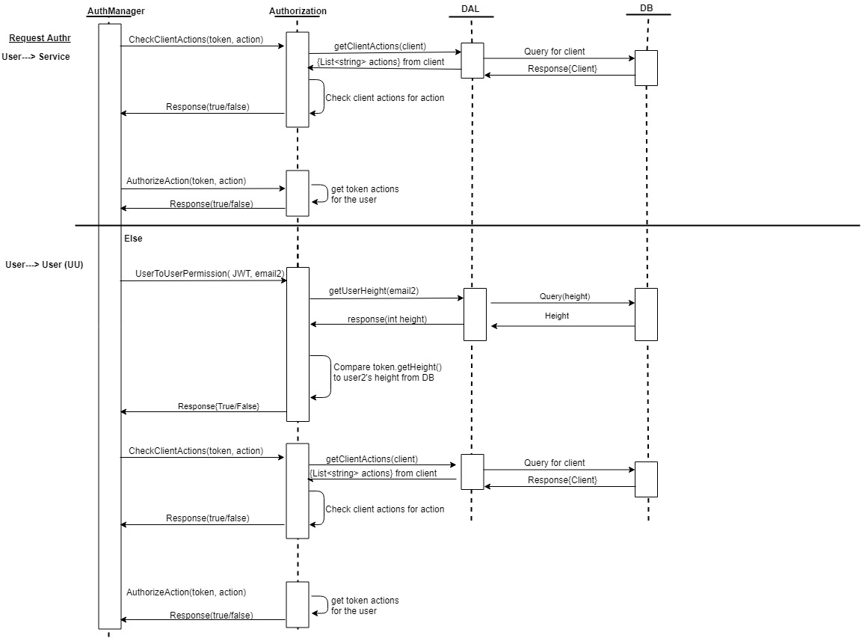
Authorization Sequence Diagram

